Slide 1
TEAM: TRITS
Contributions-to-financial-intermediary-funds

Slide 2
MEMBERS
NAME :: KRITIKA KAPOOR SRN :: PES1201701868 EMAIL-ID :: kritika90mahi@gmail.com COLLEGE :: PES UNIVERSITY NAME :: PRATYUSHA K SRN :: PES1201701831 EMAIL-ID :: prathusha1999@gmail.com COLLEGE :: PES UNIVERSITY
NAME :: SHIVANGI RAJ SRN :: PES1201700098 EMAIL-ID :: shivangraj902@gmail.com COLLEGE :: PES UNIVERSITY

Slide 3
ABSTRACT
Our dataset is based on the contribution given by Financial Intermediary Fund of a particular date. The dataset Indicates whether a contribution was received as cash or a promissory note/letter of credit and Indicates whether the contribution is categorized as Capital, Grant or Loan . It contains Name of a donor country or organization, Shows donor country code if applicable, Quarter when the contribution was received , year when the contribution was received , Currency in which the contribution was paid , and amount in the receipt currency.

Slide 4
DATASET
The dataset used for the analysis is a public dataset which is obtained from Kaggle. Link to the particular dataset is (https://www.kaggle.com/theworldbank/contributions-to-financial-intermediary-funds.)
The dataset contains 600 observations and 13 features . The dataset chosen is a large dataset .

Slide 5
FEATURES OF THE DATASET::
Date
Fund name
Donor name
Donor country code
Receipt code
Receipt Quarter
Receipt Amount
Calendar year
Receipt currency
A contribution type
A sub account
Amount in USD
A sector/theme

Slide 6
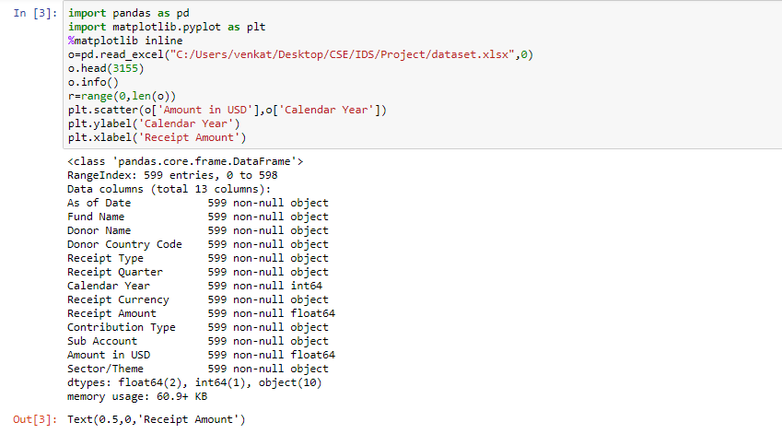
Modules Used

Slide 7
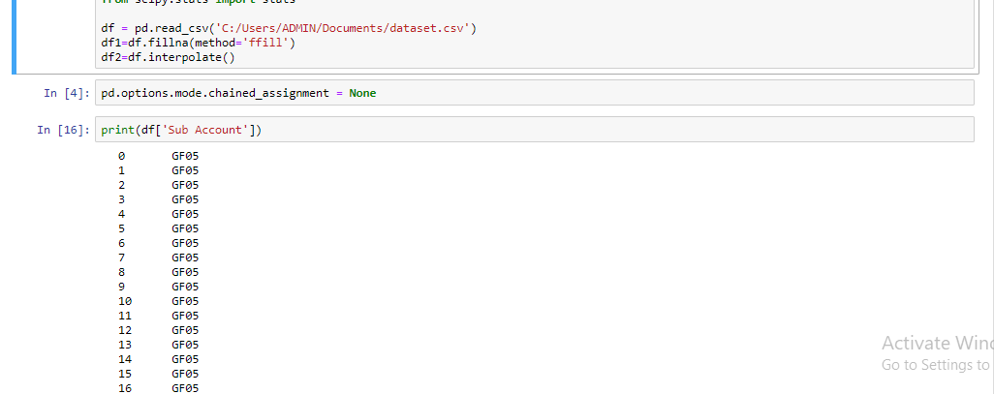
Data Cleaning

Slide 8
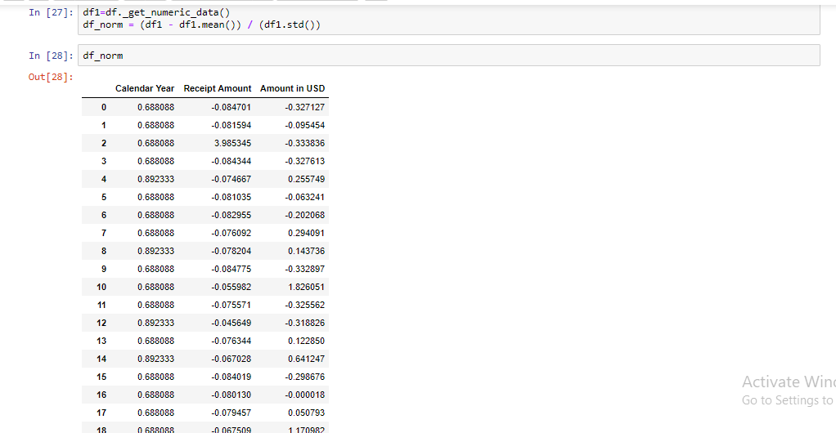

Slide 9
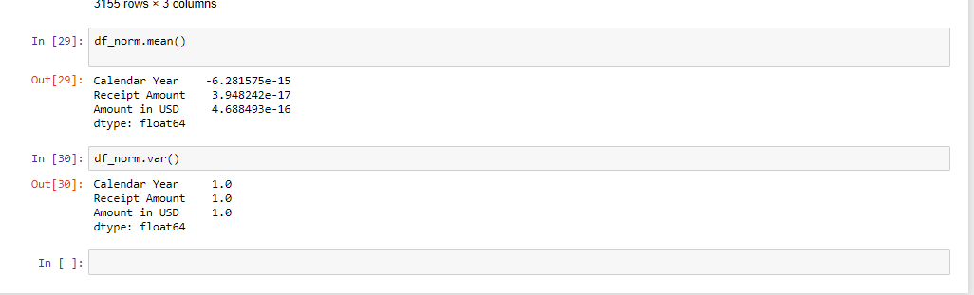

Slide 10
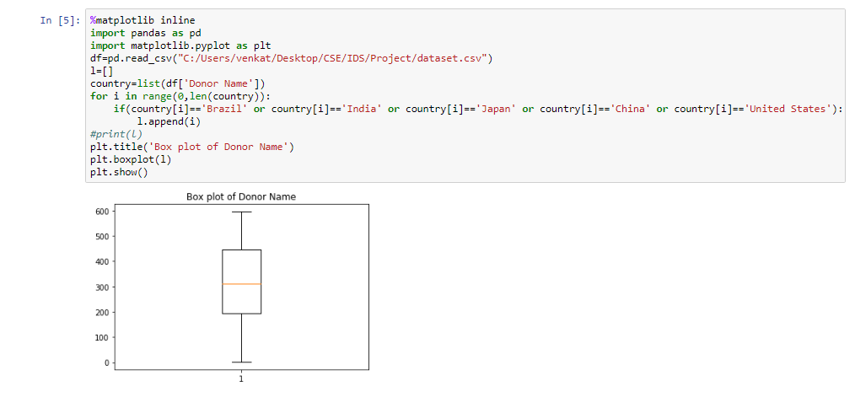
Data Visualization BOX PLOT

Slide 11
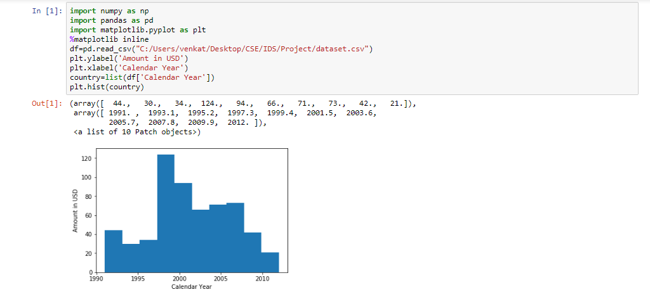
HISTOGRAM

Slide 12
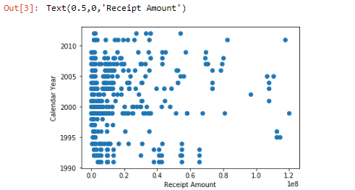
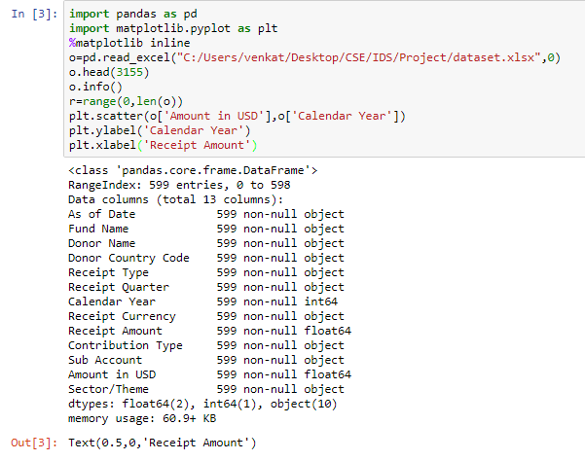
SCATTER PLOT
CODE::
GRAPH

Slide 13
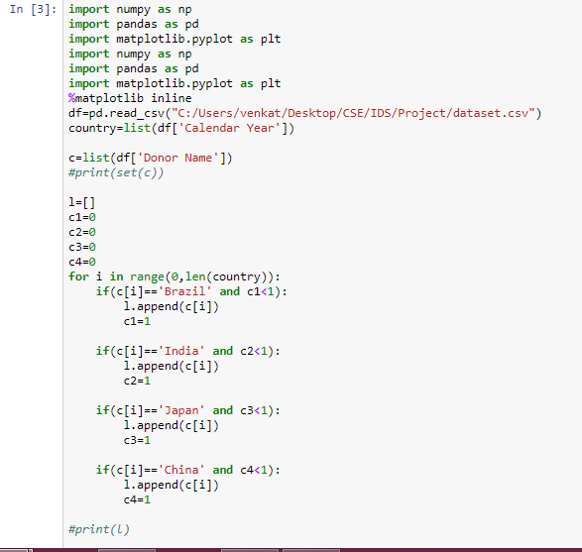
BAR CHART CODE::

Slide 14
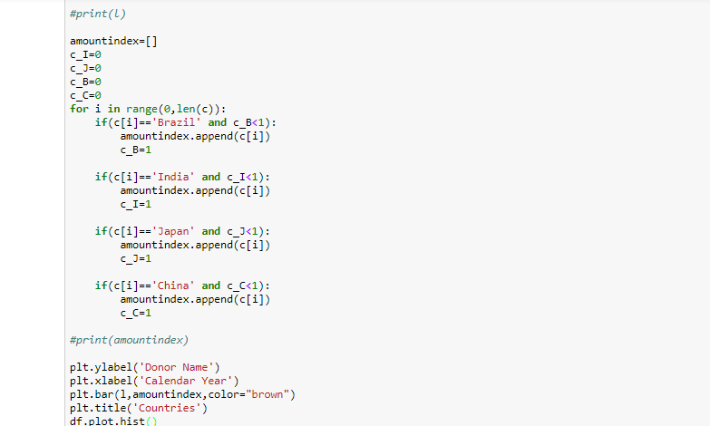

Slide 15
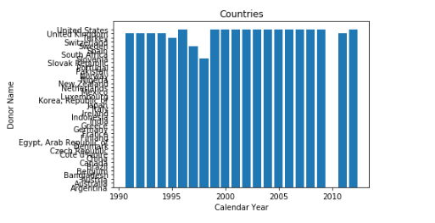

Slide 16
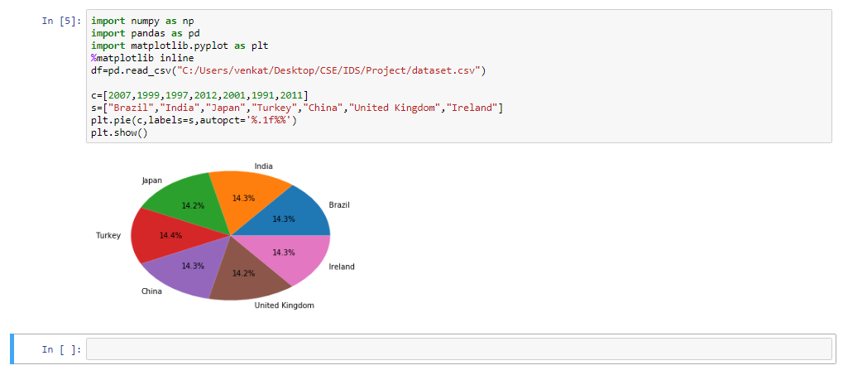
PIE CHART CODE:: OBSERVATIONS

Slide 17
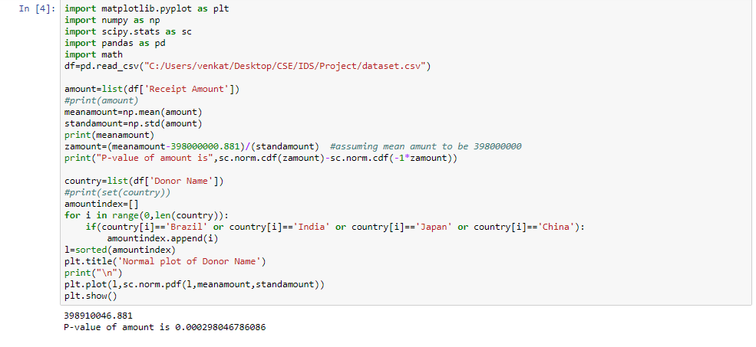
HYPOTHESIS TESTING AND LINE GRAPH

Slide 18
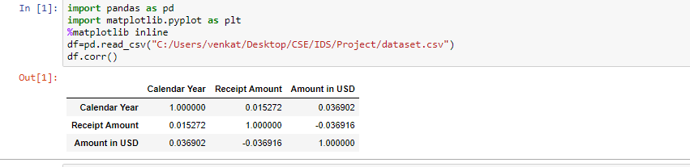
CORRELATION
CODE & OBSERVATION::
CORRELATION

Slide 19
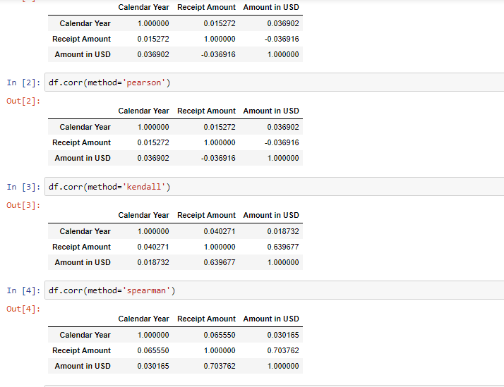

Slide 20
CONCULSION: As the years are passing we see that the funds given by different countries were gradually increasing except for one year.

Slide 21
Thank You

